Slide 1
Welcome to Your Child’s Middle School English Class

Slide 2
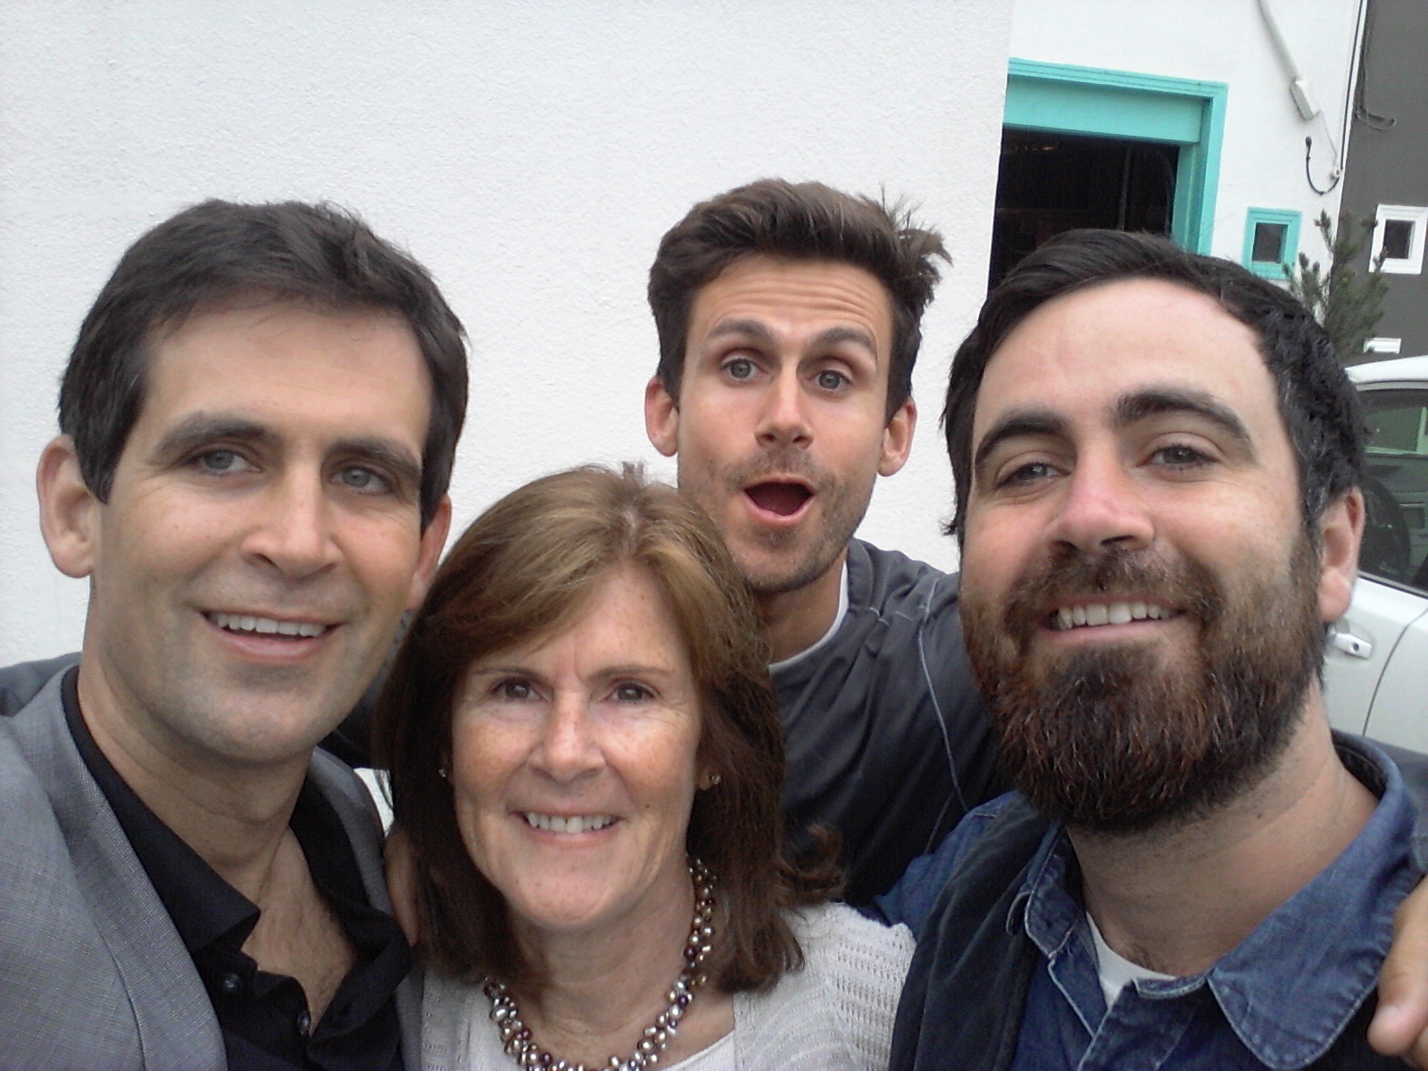
About Mr. Bono:
I have worked as a teacher, teacher leader, assistant principal, and head of school in the United States and Costa Rica for more than 13 years;
speak English and Spanish (will be studying French);
hold a bachelor’s degree in English literature and a master’s degree in Educational Leadership;
have experience in English language development; and
am the assistant middle school boys’ soccer coach at ASM.

Slide 3
Class expectations
All students are expected to be heroes in the classroom.
Honesty
Effort
Respect
Organization

Slide 4
MATERIALS NEEDED DAILY – THANK YOU!!!
Bound notebook filled with lined paper (tall, at least 100 pages)
Two-ring binder for keeping handouts and loose sheets (not just a folder with pockets)
Blue or black ink pens (multiple, in case one runs out)
Pencils and sharpener
Colored pencils (6-12)
Post-It sticky notes for annotating texts
A portfolio envelope (a “Friday” folder)

Slide 5
GRADE 6 – COURSE OVERVIEW (UNIT 1)

Slide 6
GRADE 6 – COURSE OVERVIEW (UNIT 2)

Slide 7
GRADE 6 – COURSE OVERVIEW (UNIT 3)

Slide 8
GRADE 6 – COURSE OVERVIEW (UNIT 4)

Slide 9
GRADE 7 – COURSE OVERVIEW (UNIT 1)

Slide 10
GRADE 7 – COURSE OVERVIEW (UNIT 2)

Slide 11
GRADE 6 – COURSE OVERVIEW (UNIT 3)

Slide 12
GRADE 7 – COURSE OVERVIEW (UNIT 4)

Slide 13
GRADE 8 – COURSE OVERVIEW (UNIT 1)

Slide 14
GRADE 8 – COURSE OVERVIEW (UNIT 2)

Slide 15
GRADE 6 – COURSE OVERVIEW (UNIT 3)

Slide 16
GRADE 8 – COURSE OVERVIEW (UNIT 4)

Slide 17
GRADE 6 – WRITING AND PORTFOLIOS
Extended writing this year will include both timed and process writing with at least:
2 narrative pieces,
2-3 persuasive essays,
2-4 responses to literature, and
a final exam.
Portfolio assignment – a major grade assignment at the end of the year.

Slide 18
GRADE 7 – WRITING AND PORTFOLIOS
Extended writing this year will include both timed and process writing with at least:
2-3 persuasive essays,
2-3 summaries of reading,
2-4 responses to literature, and
a final exam.
Portfolio assignment – a major grade assignment at the end of the year.

Slide 19
GRADE 8 – WRITING AND PORTFOLIOS
Extended writing this year will include both timed and process writing with at least:
2 narrative pieces,
2-3 persuasive essays,
3-5 responses to literature, and
a final exam.
Portfolio assignment – a major grade assignment at the end of the year.

Slide 20
Grading Scheme
Major Assignments and Tests = 40%
Minor Assignments and Quizzes= 30%
(Includes larger homework)
Classwork = 25%
(Includes smaller homework)
Bonus Points = 5%

Slide 21
MISSING ASSIGNMENTS, TARDIES, AND ABSENCES
EXCUSED ABSENCE – 2 days to make up assignment
MISSED WORK – 50% the next day, 0 after that (but still need to make it up at lunch or snack)
TARDY – minus 1 pt. under five minutes
10+ ABSENCES - grade for the term reduced by 1% per absence.

Slide 22
HOMEWORK EXPECTATIONS
You should expect to see your child doing:
roughly 60 to 90 minutes of homework per day (all classes)
Regular reading and writing at home
Homework that reinforces skills / knowledge already taught in the classroom.

Slide 23
Routines and Methods
Variety of instructional methods:
Daily writing warm-up
Friday independent reading (SSR)
Comprehensible input
Differentiation
Direct instruction, guided practice and independent practice
Collaboration (structured and with individual accountability)
Project-based learning
Metacognition and study/organizational skills
Multiple modalities

Slide 24
Assessments
Written work (checked for completion, content)
Spoken participation and responses to teacher questioning
Teacher observation of student independent and group work
Student self-assessment

Slide 25
CHECKING YOUR CHILD’S WORK AND GRADE
ENGRADE
CLASS WEB SITE:
ASMMSENGLISH.WEEBLY.COM
JBONO@ASM.AC.MA
MEETINGS

Slide 26
COMMUNICATION
I believe communication is key.
Please email jbono@asm.ac.ma if you have any questions or concerns. I will do my very best to respond within 24 hours.
I will schedule a meeting and arrange for a translator as needed.

